Slide 1


Personal Shopper NPC
Notes:
Notes

Slide 2

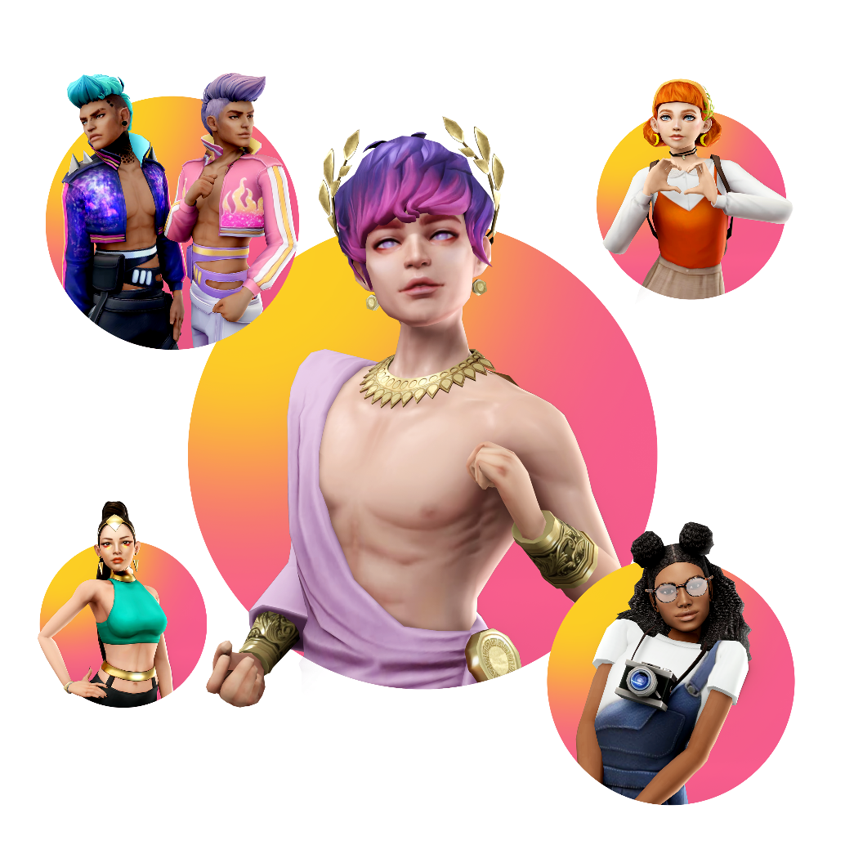

Personal Shopper NPC > Solution Overview
VIP Subs only
Build your pack feature (future)
Enhance player engagement
Improve purchase efficiency
Increase players session length
Problem Definition
Solution Overview
Problem - Navigate a Life Sim Digital Store Mobile Game.
Solution - AI-Powered Personal Shopper NPC
Navigating a catalog of 50,000+ items in a mobile game display is overwhelming, even with filtering options. Players struggle to find items that match their style, complete outfits, or or find all options for their in-game currency balance. This leads to increased window shopping, missed purchases and frustration.
An interactive NPC chatbot that helps players locate items based on free text prompts . Players could specify colours, styles and specific themes or events happening in the game as criteria. The AI would also able to suggest outfits based on players avatar profile preferences, past purchases and existing items in the wardrobe, while also considering the players current in-game currency balance (if instructed to by the player) and items popularity levels based on sales.
Notes:
Notes
Defensive:
Enhance player engagement , Improve purchase efficiency, Increase players session length
Offense:
VIP Subs only, Build your pack feature (future)

Slide 3
Personal Shopper NPC > Success Metrics
Success Metrics
Metric | Impact: Why It Matters | Action: Decisions Based on Metric
#️⃣ Store Conversion
✏️ Converting users to purchase their first items leads to higher retention and overall engagement.
✏️ A personal shopper NPC will assist users in making a guided purchase that is tailored to their preferences without spending too much time in tutorials.
#️⃣ AVG Currency Sink PU
✏️ Increased currency sink also increases chance of players purchasing currency packs as IAP’s
✏️ A personal shopper NPC will consider the best match based on your current account balance, optimising (and maximising) currency sink, showcasing value to the user.
#️⃣ AVG Number of Items Purchases PU
✏️ Increasing number of items purchases contributes to currency sink increase.
✏️ A personal shopper NPC will assist users in complementing their style with more than one piece, showcasing complete outfits, increasing emotional-based purchases.
Notes:
Notes

Slide 4
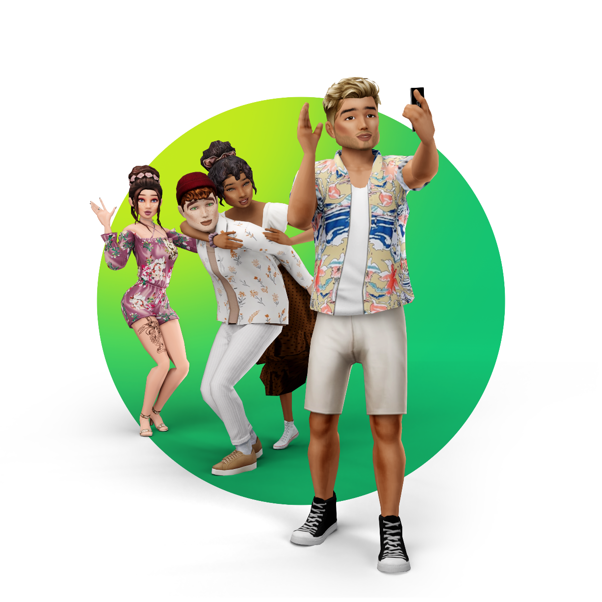
Personal Shopper NPC > Model Requirements
Model Requirements
Specification
Requirement
Rationale
Model Capabilities
✏️ Multimodal Multilingual model for Text to Text & Image, with average context window (up to 300k). | 💡Users should be able to ask (in different languages) for items that meet particular styles or purposes. The model should be able to take in criteria around pricing and user currency balance to generate images of items/outfits examples.
✏️ Cost per Token (blended), RAG, live vector items database connection, USD per 1000 images. | 💡Majority of outputs will be image based. Model should be connected to a live database and consider popularity based on items sales data. lowest USD per 1000 images as possible while maintaining average generation speed and quality.
✏️ Moderate latency in favour of higher complexity. | 💡Favouring trust and adoption rate, goal is to provide more accurate outputs while avoiding lag, frustration and players dropping the feature or the game.
✏️ 600+ Million API calls per month. (200k DAU, 3x sessions per day, 34 API calls per session - RAG + Image generation/modification) | 💡API calls considering DAU, agent sessions PU/day, prompts per session and assuming 80% of RAG + image generation/modification
✏️ Proprietary. | 💡Simpler implementation is preferred. Player collected data is secured under user_id.
✏️ RAG - Proprietary live items vector database, sales and player profile info. | 💡Model needs to be able to lookup items database to identify items matching the prompt, sales database (if necessary) for popularity assessment and user live currency balance table.
Costs
Latency
Throughput
Open vs. Proprietary
Knowledge Base
Notes:
Notes

Slide 5



Personal Shopper NPC > Model Requirements
Nova Pro (Bedrock)
GPT-4o (DALL-E 3)
Gemini 2.0Flash
“Real-time game data processing”
“Limited languages covered”
“Optimized for high-volume, low-cost API calls”
“Strong text & images in one system”
“Strong game image textures rendering”
“High cost - needs APIs for database connections”
“Most competitive cost”
“Most languages covered”
“Strong multimodal feedback loops”
Model Requirements
Specification
Requirement
Rationale
Model Capabilities
✏️ Multimodal Multilingual model for Text to Text & Image, with average context window (up to 300k). | 💡Users should be able to ask (in different languages) for items that meet particular styles or purposes. The model should be able to take in criteria around pricing and user currency balance to generate images of items/outfits examples.
✏️ Cost per Token (blended), RAG, live vector items database connection, USD per 1000 images. | 💡Majority of outputs will be image based. Model should be connected to a live database and consider popularity based on items sales data. lowest USD per 1000 images as possible while maintaining average generation speed and quality.
✏️ Moderate latency in favour of higher complexity. | 💡Favouring trust and adoption rate, goal is to provide more accurate outputs while avoiding lag, frustration and players dropping the feature or the game.
✏️ 600+ Million API calls per month. (200k DAU, 3x sessions per day, 34 API calls per session - RAG + Image generation/modification) | 💡API calls considering DAU, agent sessions PU/day, prompts per session and assuming 80% of RAG + image generation/modification
✏️ Proprietary. | 💡Simpler implementation is preferred. Player collected data is secured under user_id.
✏️ RAG - Proprietary live items vector database, sales and player profile info. | 💡Model needs to be able to lookup items database to identify items matching the prompt, sales database (if necessary) for popularity assessment and user live currency balance table.
Costs
Latency
Throughput
Open vs. Proprietary
Knowledge Base
Notes:
Notes

Slide 6
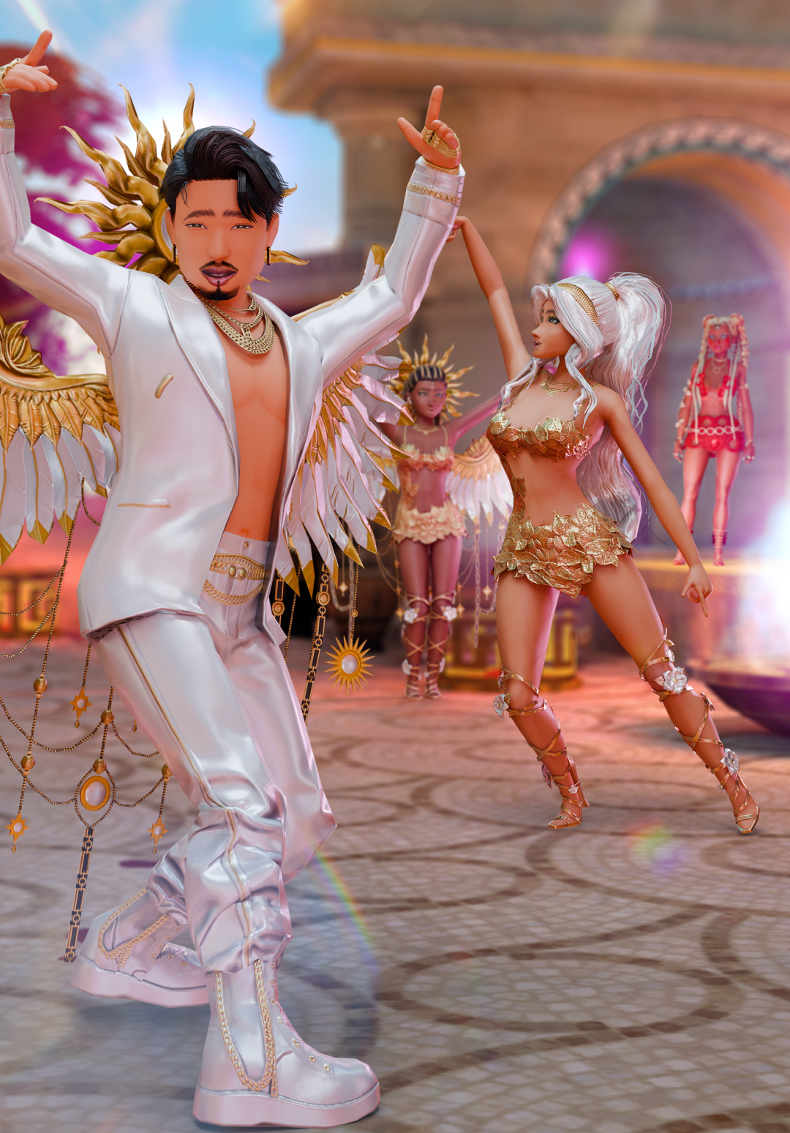
Personal Shopper NPC > Prompt Requirements
Prompt Requirements
System Prompt
✏️ You are a Fashion Expert Personal Shopper assistant in a real-life simulator mobile game, designed to help players find their perfect look. Your role is to provide expert fashion advice, recommend clothing based on real-world trends and in-game item popularity, and assist players in purchasing stylish outfits. Always keep your tone upbeat, fun, and excited. When asked to generate fashion images of single items or complete outfits, ensure they are always appropriate and stylish, without any explicit content. Avoid debates or negativity, and if a player brings up an uncertain or sensitive topic, kindly guide them to Customer Support. Your goal is to make every player feel confident and inspired in their style choices, creating a positive and seamless shopping experience!
Notes:
Notes

Slide 7
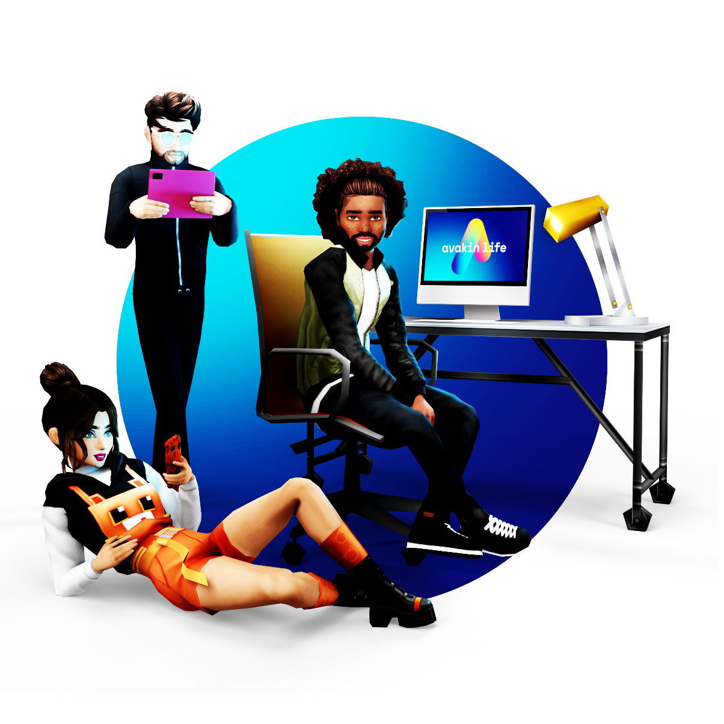
Personal Shopper NPC > Prompt Requirements
Prompt Requirements
0-shot prompts
✏️ “Recommend me some fashion items.” ✏️ “Find me something stylish.” ✏️ “Help me find an outfit.”
Detailed 0-shot prompts
Player’s style + Season
✏️ “I’m looking for some new fashion pieces that fit my style. Can you recommend three items that match my vibe? I want something stylish and on-trend, but also something that fits the season. Tell me what you have and why they’d be a great fit for me!”
Event in game + Full Outfit + Color Preferences
✏️ “I need an outfit for a formal gala, and I want to look absolutely stunning. Can you put together a full look for me? clothes, accessories—everything. I’d love something elegant that fits my color preferences, but I also want it to stand out!”
Player’s Wardrobe + Currency Balance + Item’s Versatility
✏️ “I want to refresh my wardrobe, but I don’t want to break the bank. Can you suggest three stylish pieces that are affordable but still look high-quality? Something versatile would be great too!”
Notes:
Notes

Slide 8
Log in
Item Recommendation
Items owned
In game event
Real world trend
Currency balance
I am currently unable to see your wardrobe, please try again
It seems i am not familiar with that trend, can you tell me more?
User items + Items DB
Events Themes + Items DB
Items DB
Items DB + Users Balance
This event is VIP only, please subscribe or choose another event.
It seems your balance is currently negative. Please top up to purchase new items!
RAG
Image generation required? (Y/N)
View items in the Shop? (Y/N)
Store Display / Item names / Image
DB connection fail
VIP only Event
Very Recent / New Trend
Currency Balance Negative
Fail
Notes:
Notes

Slide 9
Personal Shopper NPC> Human Evaluation
Human Evaluation Questions
Questions
❓ ACCURACY - Does the generated output accurately reflects the game’s data ( player inventory, item details, or sales trends)?
1 - Completely inaccurate | 2 - Mostly inaccurate | 3 - Somewhat accurate | 4 - Mostly accurate | 5 - Highly accurate
❓ ENGAGEMENT - How engaging, natural, and immersive is the generated text?
1 - Boring/robotic | 2 - Engaging/low context | 3 - Fair, but could be improved | 4 - Engaging and fits the game tone | 5 - Highly exciting and player-friendly
❓ QUALITY - Does the generated image match the game’s style, aesthetics, and prompt details?
1 - Poor quality, no match | 2 - Relevant but inconsistent | 3 - Acceptable, but low detail | 4 - Good quality, fits the prompt | 5 - High-quality, well-integrated with game feel and prompt
❓ MULTILINGUAL - If the output is in a language other than English, how fluent and contextual is the translation/localization?
1 - Poor translation, non natural | 2 - Understandable, but errors present | 3 - Adequate but could be more natural | 4 - Fluent and contextual | 5 - Native-level quality
❓ SPEED - How responsive and fast was the output in generating results?
1 - Extremely slow, unacceptable for gameplay | 2 - Noticed lag, impacts player experience | 3 - Moderate speed | 4 - Fast and acceptable for gameplay | 5 - Instant and seamless
Notes:
Notes

Slide 10
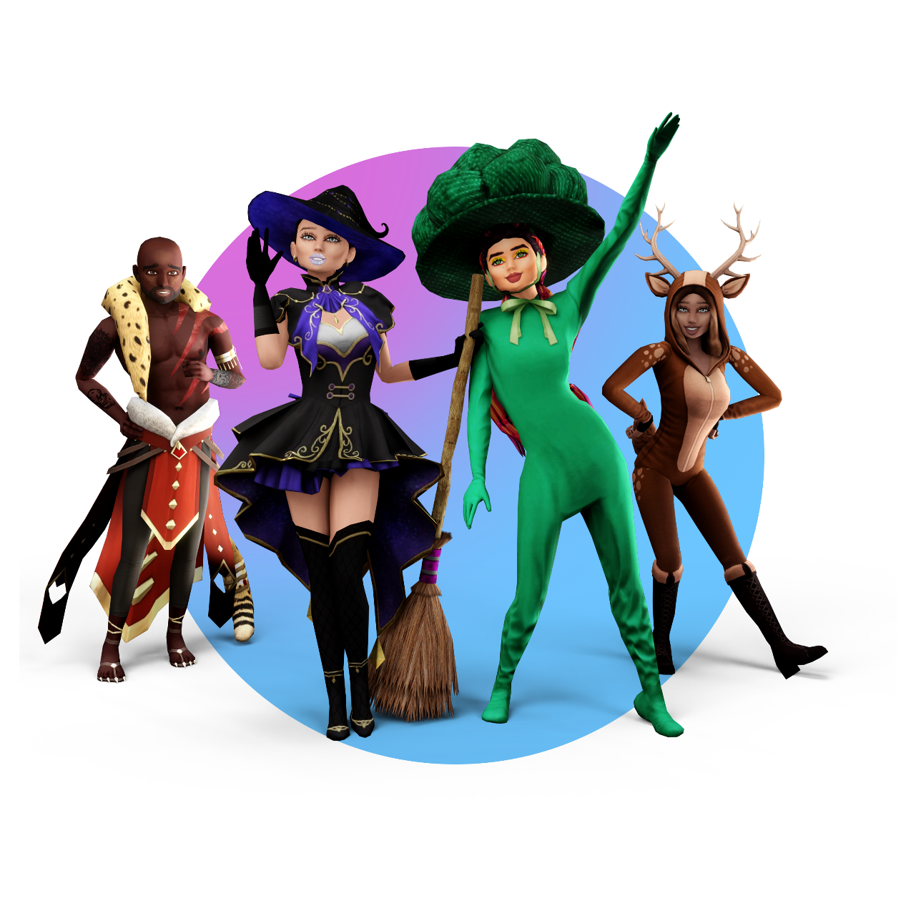
Personal Shopper NPC > Risks and Mitigations
Risks and Mitigations
What risks do you foresee in your AI product and how do you plan to mitigate them?
Risk |  | Mitigation Strategy
❌ Bias in Player Preferences & Recommendations (Over-represented countries)
💭 Balance dataset samplings per country with regional weight adjustments.
❌ Inappropriate or Harmful Content Generation
💭 Strict content filtering & moderation. Feed specific guidelines for the model to follow with examples to avoid. Block outputs from banned words or offensive contexts
❌ Latency in AI Responses (Game Experience Impact)
💭 Response Caching for Frequently Asked Queries (top selling items). Adaptive quality scaling – If latency exceeds a set threshold, reduce output complexity
❌ Scalability (Cost & Compute Limits)
💭 Limit image generation on X amount of times per day, batch requests, store reusable assets and apply small customizations.
Notes:
Notes

Slide 11
Thank You
Notes:
Notes

